Slide 1

Good Warehousing Practices

Slide 2

CONTENTS
Introduction
Objectives
What is GWP?
Importance of GWP
Good Warehousing Practices
Synthesis
Quiz

Slide 3
INTRODUCTION
The success of warehouse management is the foundation of the overall success of a logistics business. A bad warehouse management can destroy the business while a good warehouse management can attract more clients which can build a stronger company image. It increases the over all revenue of the company which will benefit the employer as well as the employees.
A need for well-trained workers is imperative to improve customer satisfaction and strengthen warehouse operational productivity.
This comprehensive module is designed for all employees across all sites to help them remember how Good Warehousing should be practiced.

Slide 4
OBJECTIVES
At the end of this module:
Define what Good Warehousing Practice is.
Identify good practices inside a warehouse.

Slide 5

GOOD WAREHOUSING PRACTICE
GWP is a set of standardized procedures in managing a safe, effective, and productive warehouse operations.

Slide 6

GOOD WAREHOUSING PRACTICE
Procedures include ensuring the efficient flow of products in and out of the facility, optimizing the building’s layout, making sure orders are fulfilled and products are in stock, but not overstocked.

Slide 7

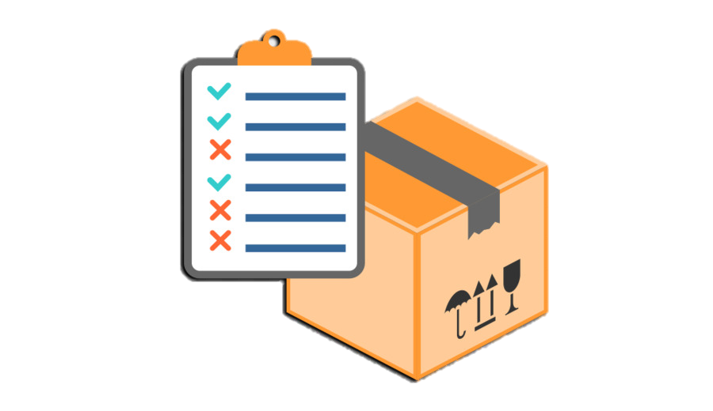

Good and adequate warehousing practices will ensure:
IMPORTANCE
Products are always be accessible
Products are always in good condition
Products are always available

Slide 8



GOOD WAREHOUSING PRACTICES
Loading and Unloading
Inventory Management
Warehouse Condition

Slide 9
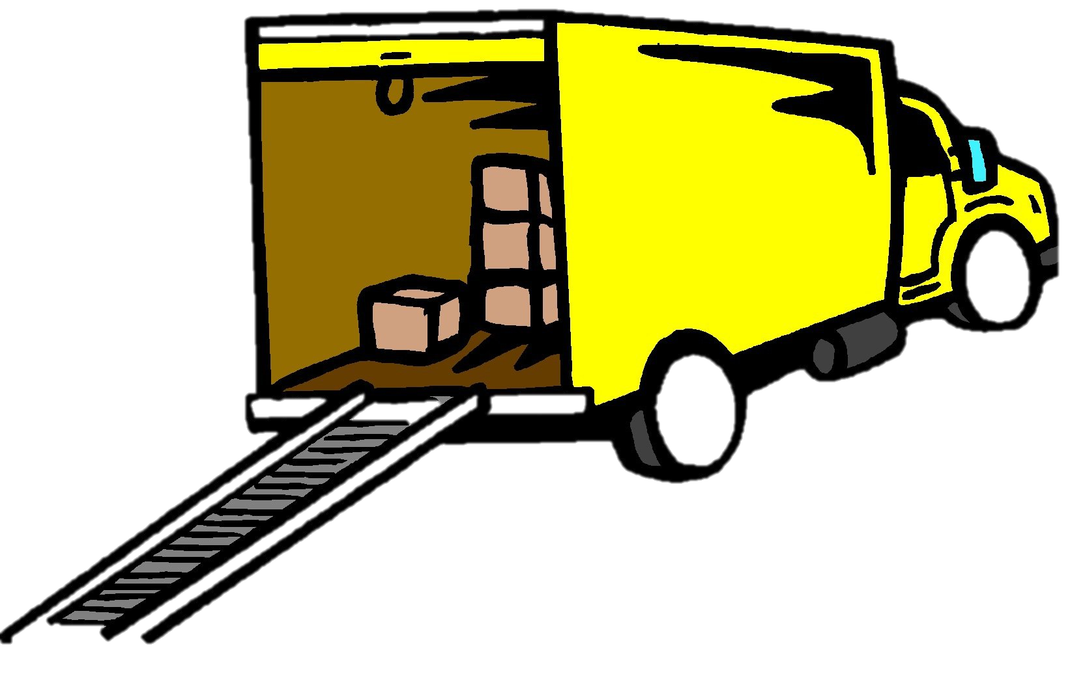
GOOD WAREHOUSING PRACTICES
LOADING AND UNLOADING
Make sure that trucks are clean and don’t have strong odors.
Check Temperature of Trucks (For frozen products)
Clean boxes before loading into the truck

Slide 10

GOOD WAREHOUSING PRACTICES
LOADING AND UNLOADING
Forklift trucks should be clean, no hydraulic oil leaks, and always being monitored.
Forklifts should be powered by electricity or LPG. Diesel is not allowed.

Slide 11

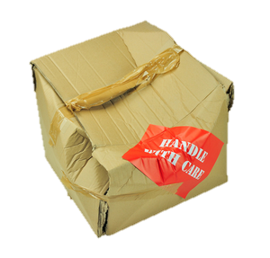

GOOD WAREHOUSING PRACTICES
INVENTORY
Food should be separated to inedible things.
Clean immediately damaged products or spilt products

Slide 12

GOOD WAREHOUSING PRACTICES
INVENTORY
Racks should be clean, no spider web or grimes
There should be a separation of products whether Good, Hold, or Bad product

Slide 13
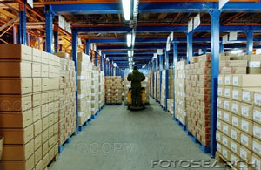
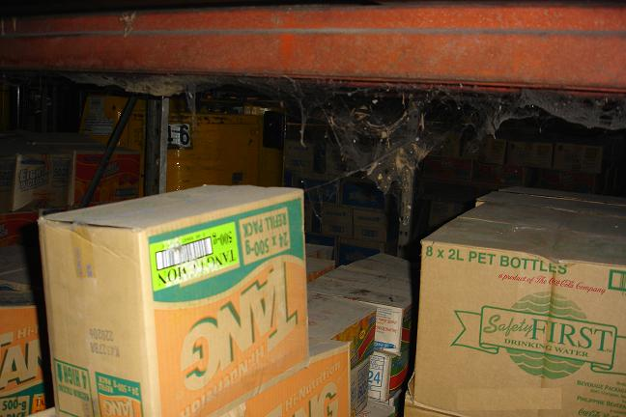


GOOD WAREHOUSING PRACTICES
INVENTORY

Slide 14
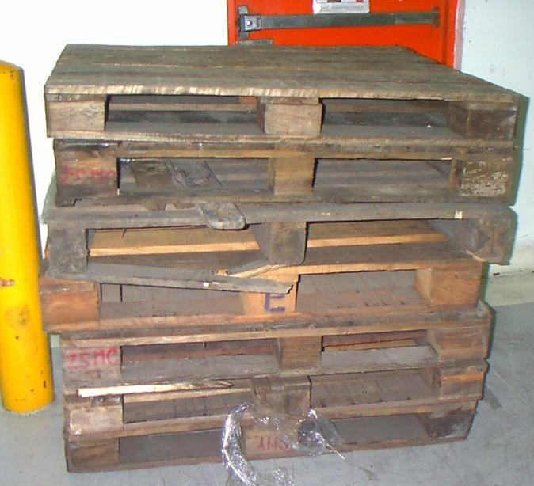
GOOD WAREHOUSING PRACTICES
INVENTORY
Products should be placed on a pallet.
Dirty and broken pallets should not be used anymore.

Slide 15
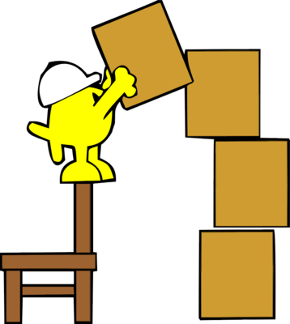
GOOD WAREHOUSING PRACTICES
INVENTORY
There should be 18 inches distance between the pallets and wall.
Follow the appropriate stacking height requirement
STACKING HEIGHT: How boxes, containers are piled or stored together.

Slide 16
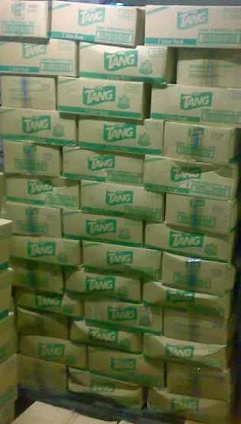
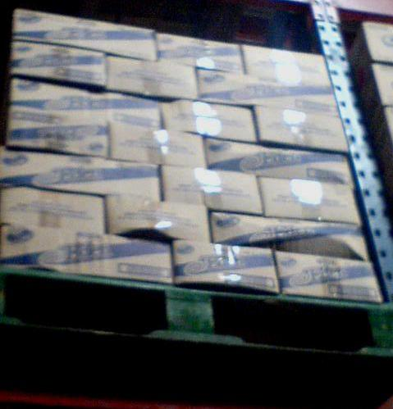
GOOD WAREHOUSING PRACTICES
INVENTORY
Overstacking

Slide 17
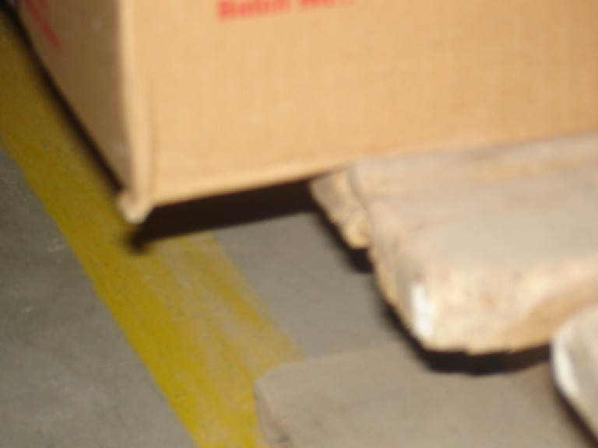
GOOD WAREHOUSING PRACTICES
INVENTORY
OVERHANG
Boxes should be properly placed in pallets.
Avoid overhanging the boxes.

Slide 18
GOOD WAREHOUSING PRACTICES
WAREHOUSE CONDITION
Don’t stand or sit on the boxes
All boxes should have labels
The warehouse should be properly ventilated to prevent condensation

Slide 19


GOOD WAREHOUSING PRACTICES
WAREHOUSE CONDITION
Openings leading to exterior should be meshed to prevent the entry of pests.
Windows should be kept closed or in some instances, installed with insect-mesh screens.

Slide 20


GOOD WAREHOUSING PRACTICES
WAREHOUSE CONDITION
Cleaning materials or any other hazardous chemicals should not be stored in the warehouse, but in designated areas with proper labelling.

Slide 21
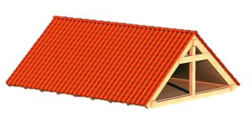

GOOD WAREHOUSING PRACTICES
WAREHOUSE CONDITION
Roofs shouldn’t have holes
Warehouse should have proper lighting
All bulbs should have covers or plastic coats.

Slide 22

GOOD WAREHOUSING PRACTICES
WAREHOUSE CONDITION
Roofs shouldn’t have holes
There should be pest management practices in place to prevent the harborage and breeding of pests on the grounds and within the warehouse facility.

Slide 23
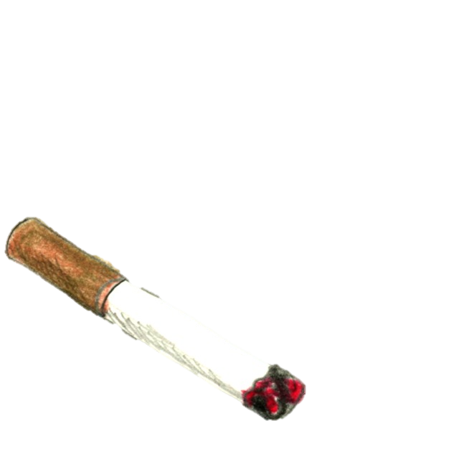




GOOD WAREHOUSING PRACTICES
PERSONAL HYGIENE
Eating, drinking, smoking, chewing of gum or littering and other undesirable behavior is NOT allowed inside the warehouse.

Slide 24
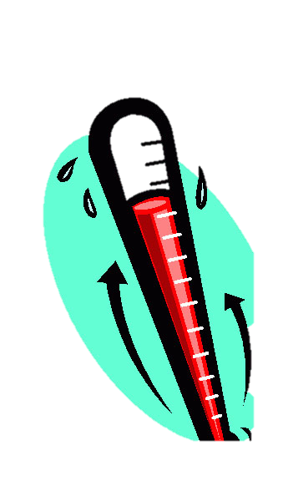

GOOD WAREHOUSING PRACTICES
PERSONAL HYGIENE
Any person who has or appears to have an infectious disease, open lesion, including boils, sores, or infected wounds, or any other abnormal source of microbial contamination must be excluded from any operations.

Slide 25
SYNTHESIS
Good Warehouse Management starts with Good Warehouse Practices in loading and unloading of products, inventory, warehouse condition, and workers’ personal hygiene. Being aware of the standards and procedures will result to a productive and safe warehouse operations.

Slide 26

To ensure that you have learned something about our topic, let’s take a short quiz!

Slide 27
QUIZ
1. In your own words, define what Good Warehousing Practice is.

Slide 28
QUIZ
2. Give ONE Good Warehousing Procedure in each of the following:
Loading and Unloading
Inventory
Warehouse Condition
Personal Hygiene

Slide 29
QUIZ
3. How did this topic helped you as a member of the PCL Operations team?

Slide 30
End of Presentation
THANK YOU!
Visit us
www.pcl.com.ph

